Slide 1

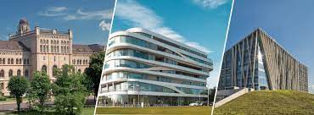

Biomaterials for medicine, pharmacy and veterinary
"Novel photoluminescence platforms for Listeria monocytogenes detection" 1.1.1.5/21/A/001

Slide 2
Main areas, expected to cover with program
Scaffolds for tissue regeneration and tissue engineering
Hemostatic materials and drug-release scaffolds
Antibacterial complexes with focus to MRSA strains
Anticancer therapy (Photo-thermal and photo-dynamic therapies)
Biocompatible coatings for dental and orthopedics implants
"Novel photoluminescence platforms for Listeria monocytogenes detection" 1.1.1.5/21/A/001

Slide 3



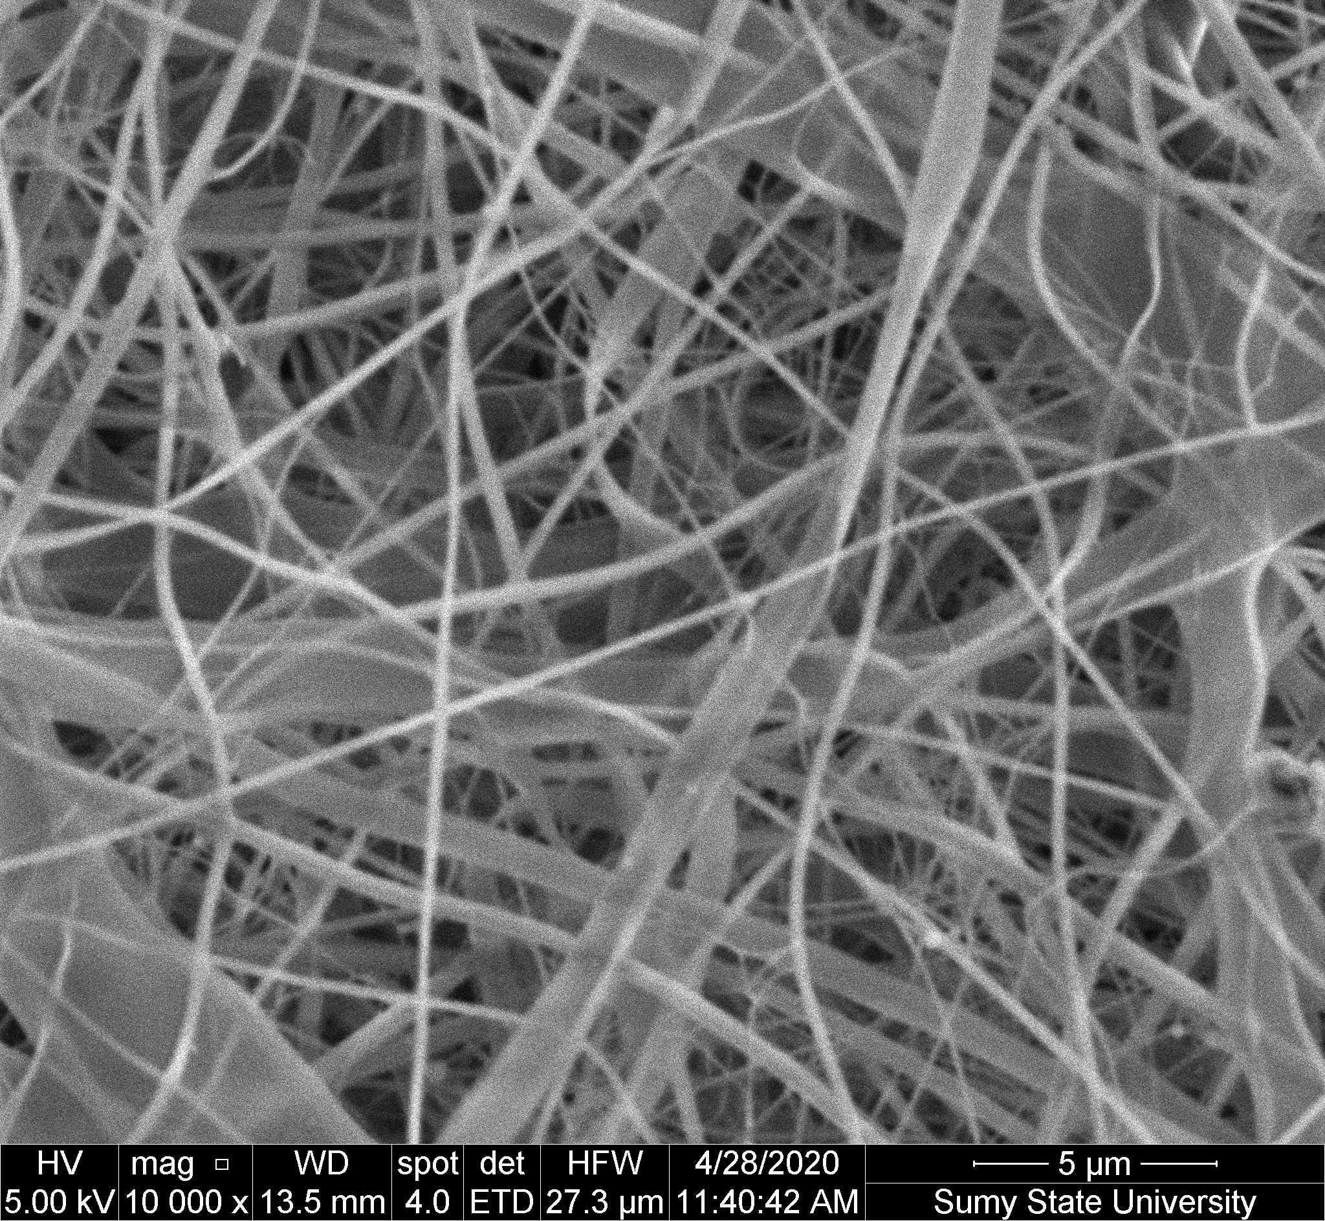
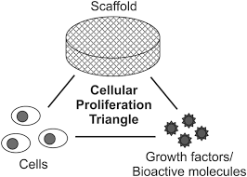

Scaffolds for tissue regeneration and tissue engineering
External partners support
LU collaboration
Electrospun and freeze-dried materials from synthetic and natural polymers
LU ASI (Dr Roman Viter)
Medical Faculty (Prof. Una Riekstina)
"Novel photoluminescence platforms for Listeria monocytogenes detection" 1.1.1.5/21/A/001

Slide 4


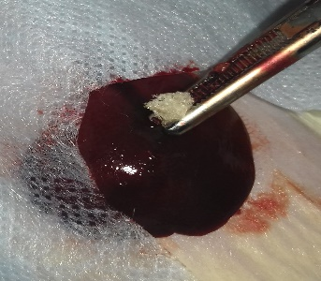

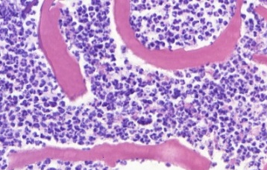
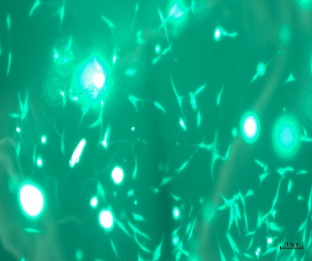
Hemostatic materials and drug-release scaffolds
External partners support
LU collaboration
Chitosan and complex sponges with hemostatic and drug-release properties
LU ASI (Dr Roman Viter)
Medical Faculty (Prof. Una Riekstina)
LU ASI (Dr Mindaugas Tamosiuna)
"Novel photoluminescence platforms for Listeria monocytogenes detection" 1.1.1.5/21/A/001

Slide 5



Antibacterial complexes with focus to MRSA strains
External partners support
LU collaboration
Metal-based nanoparticles and organic/NPs compexes
LU ASI (Dr Roman Viter)
Medical Faculty (Prof. Una Riekstina)
LU ASI (Dr Mindaugas Tamosiuna)
"Novel photoluminescence platforms for Listeria monocytogenes detection" 1.1.1.5/21/A/001

Slide 6




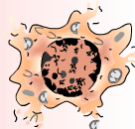
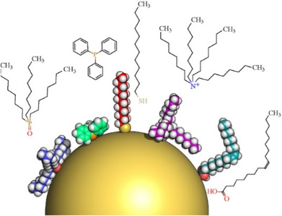
Anticancer therapy (Photo-thermal and photo-dynamic therapies)
External partners support
LU collaboration
MXene-based materials
LU ASI (Dr Roman Viter)
Medical Faculty (Prof. Una Riekstina)
"Novel photoluminescence platforms for Listeria monocytogenes detection" 1.1.1.5/21/A/001

Slide 7



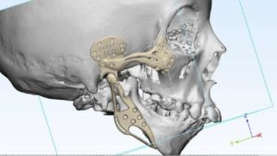
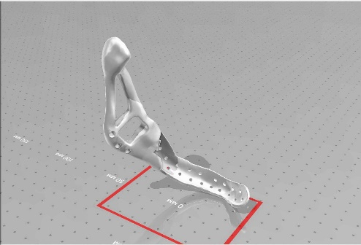

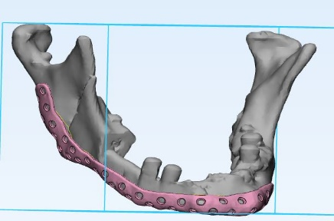
Biocompatible coatings for dental and orthopedics implants
External partners support
LU collaboration
Orthopedics and dental implants
LU ASI (Dr Roman Viter)
Medical Faculty (Prof. Una Riekstina)
Medical Microbiology Laboratory (Dr. Tatjana Tračevska)
"Novel photoluminescence platforms for Listeria monocytogenes detection" 1.1.1.5/21/A/001

Slide 8

"Novel photoluminescence platforms for Listeria monocytogenes detection"

